Slide 1
CIS 641 PRESENTATION 1
Team Name: SE3
Team Members: Shicong Liu, Quan Kong, Byron Wheeler, Tanmay Varma, Zac Throneburg (TL)
Team Project: Sudoku
Date: Monday, October 14, 2013

Slide 2
INTRODUCTION
Zac Throneburg
Time Log (Starting 10/7/13)
10/07/13 – Discuss CImage versus Bitmap
10/08/13 – Develop prototype game board image, basic game image, basic game file and solution
10/09/13 – Look into GitHub repository versus GForge
10/11/13 – Look into C++ GUI forms
10/13/13 – Finalize documents for presentation 1

Slide 3
INTRODUCTION
Byron Wheeler
Time Log (Starting 10/7/13)
10/07/13 – Discuss CImage versus Bitmap, and finalize sample image font with Zac
10/08/13 – Research CImage and test with file outputs
10/10/13 – Start initial coding in C++
10/11/13 – Attempt proof of concept for CImage in C#
10/13/13 – Correspond for presentation 1 with Zac

Slide 4
INTRODUCTION
Tanmay Varma
Time Log (Starting 10/7/13)
10/07/13 – Talk about form with button use in C++
10/08/13 – Brainstorm gameplay code mechanics
10/10/13 – Research
10/13/13 – Correspond for presentation 1 with Zac

Slide 5
INTRODUCTION
Shicong Liu
Time Log (Starting 10/7/13)
10/07/13 – Talk about form with button use in C++
10/08/13 – Brainstorm gameplay code mechanics
10/13/13 – Correspond for presentation 1 with Zac

Slide 6
INTRODUCTION
Quan Kong
Time Log (Starting 10/7/13)
Prior – Research Sudoku fundamentals and algorithms for solving. Look into number creation.
Prior – Looked into GUI and MFC in C++
10/07/13 – Discuss CImage versus Bitmap, discuss memory storage of game with Zac and Byron
10/13/13 – Correspond for presentation 1 with Zac

Slide 7
ONLINE ISSUES AND DECISION LOG
Online issues
None to date. Will be using Git for version control. No code is currently posted.
Decision log
Two teams – Image parsing (Byron and Quan), game GUI (Tanmay and Shicong), Zac will help both
Images will be “clean” and properly oriented
Images will always be the same size, colors, font, and file type
Data storage – Game board is a 2d array of size 9x9
Game files – Formatted as nine rows of 9 numbers each. Blank boxes are represented by zeroes
Save files – Formatted with the original game file and the current game state upon saving
Features – Scan and import, load game, save game, check available moves, check input for validity
User moves – Each move is checked for validity and only allowed if no conflicts will occur due to the move

Slide 8
VISION AND SCOPE DOCUMENT
See handout

Slide 9
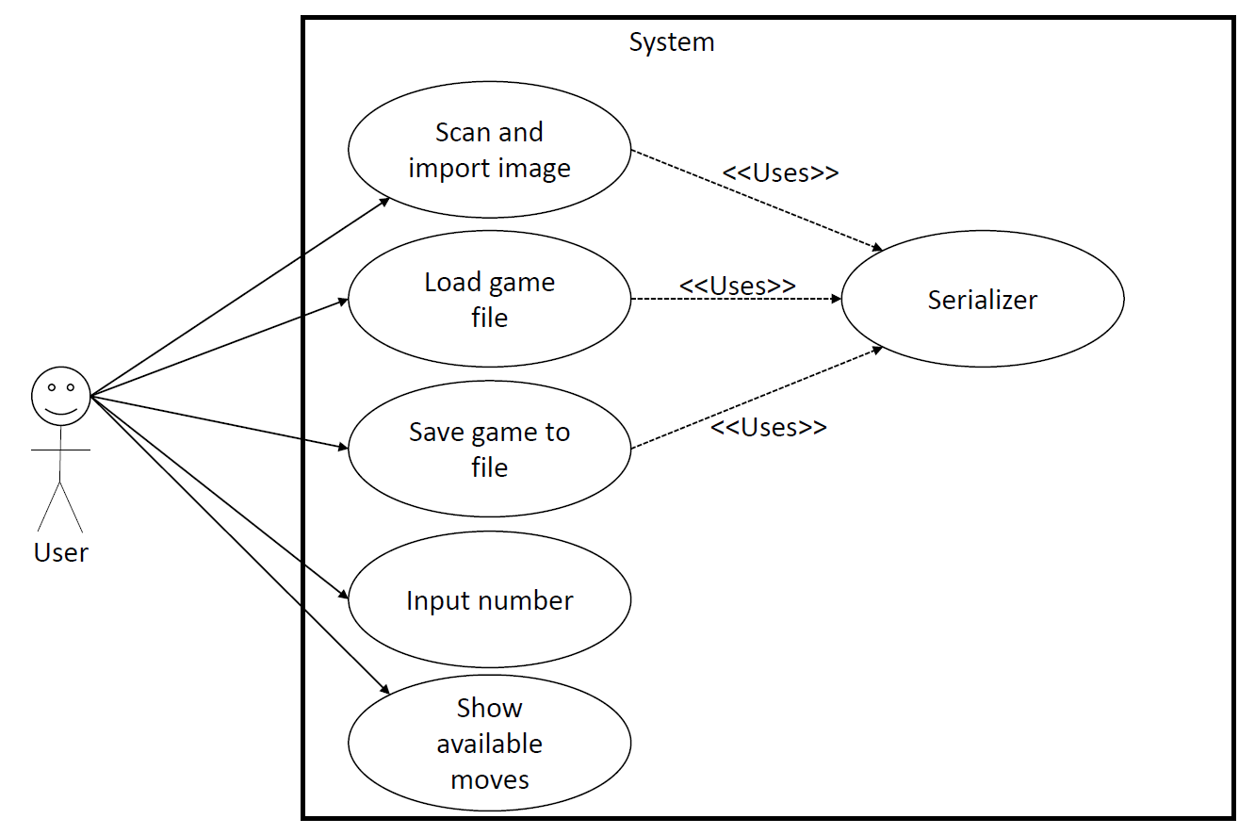
USE CASES
See handout

Slide 10
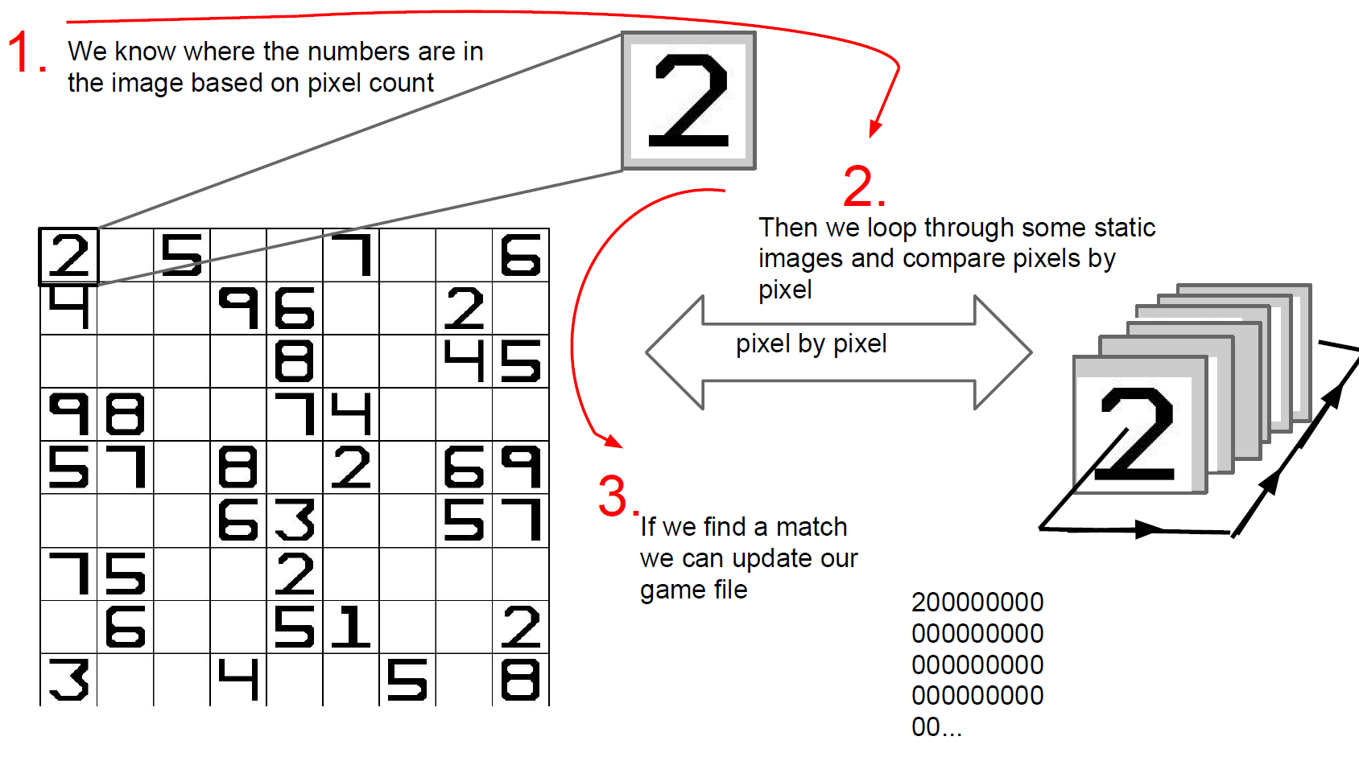
IMAGE PROCESSING

Slide 11
QUESTIONS?

